Slide 1

Health and Care
LGBTQ+ Inclusion
Framework
Insert trust logo
Briefing for board members
The inclusion framework has been developed by the NHS Confederation's Health and Care LGBTQ+ Leaders Network, in conjunction with the Mental Health Network.

Slide 2
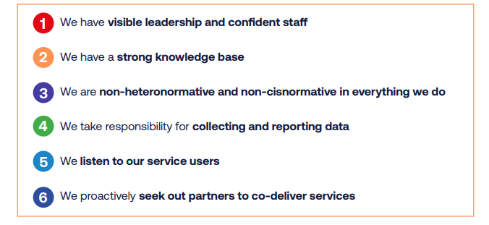
Introduction
NHS Staff Survey data shows that the LGBTQ+ workforce remains at heightened risk of physical violence from patients, and bullying, harassment or abuse from colleagues.
The NHS, along with other health and care organisations, needs to provide fair access to health and care for all, to improve the health of all parts of the population, and to be an inclusive employer.
The Health and Care LGBTQ+ Inclusion Framework comprises six key pillars of inclusivity that NHS organisations should aim to
achieve in order to create and
maintain inclusive cultures.

Slide 3
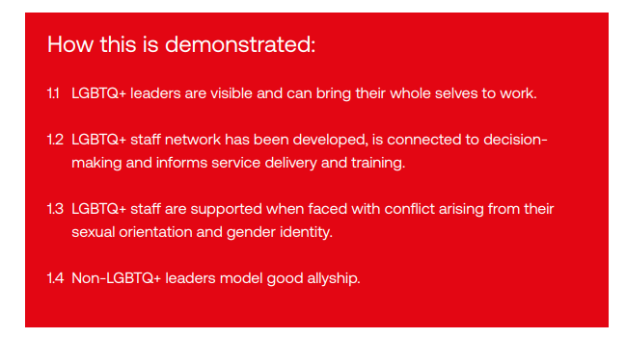
Pillar 1 - We have visible leadership and confident staff
Suggested actions:
Share the lived experience of LGBTQ+ leaders through platforms such as webinars, blogs and staff-wide meetings.
Ensure staff networks have an executive sponsor to support activities and feedback to your organisation’s board.
Make staff support, such as freedom to speak up guardians or staff networks, highly visible so colleagues know where to turn for help.
Encourage non-LGBTQ+ leadership to visibly engage in organisational activities that support LGBTQ+ staff.

Slide 4
Pillar 1 - We have visible leadership and confident staff
Our progress:
1.1 LGBTQ+ leaders are visible and
can bring their whole selves to work.
1.2 LGBTQ+ staff network has been
developed, is connected to decision-
making and informs service
delivery and training.
1.3 LGBTQ+ staff are supported
when faced with conflict arising from
their sexual orientation and gender
identity.
1.4 Non-LGBTQ+ leaders model
good allyship.
Actions to date:
Add details here

Slide 5
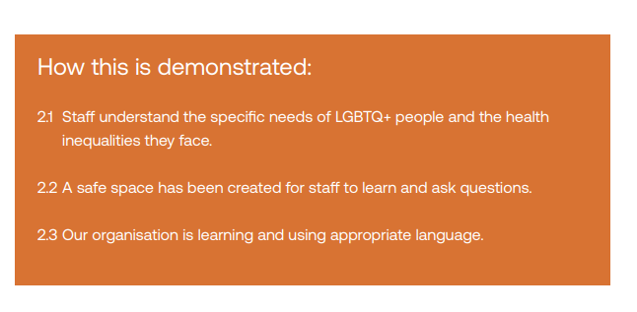
Pillar 2 - We have a strong knowledge base
Suggested actions:
Create an online learning hub for staff to access at a time that suits them.
Include lived experience of LGBTQ+ patients and staff in your training materials or presentations.
Deliver a mixed-media package of training to engage the widest range of staff.
Work with your LGBTQ+ staff network and LGBTQ+ charities to create tailored training specific to your organisation and local population.

Slide 6
Pillar 2 - We have a strong knowledge base
Our progress:
2.1 Staff understand the specific
needs of LGBTQ+ people and the
health inequalities they face.
2.2 A safe space has been created
for staff to learn and ask questions.
2.3 Our organisation is learning and
using appropriate language.
Actions to date:
Add details here

Slide 7
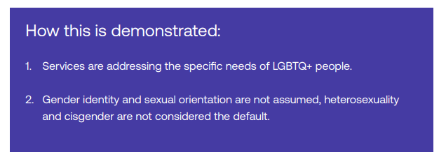
Pillar 3 - We are non-heteronormative and non-cisnormative in everything we do
Suggested actions:
Ensure equality impact assessments are being considered during the creation or review of policies and service development, not after.
Take time to review policy documents, service literature and consent forms to ensure they are appropriate for gender non-conforming or trans service users.
Make pronouns as visible as possible, encouraging staff to use them in email signatures and on name badges.
Develop a positive and productive relationship with estate management. This is a helpful first step to creating inclusive spaces such as gender-neutral toilets.

Slide 8
Pillar 3 - We are non-heteronormative and non-cisnormative in everything we do
Our progress:
3.1 Services are addressing the
specific needs of LGBTQ+ people.
3.2 Gender identity and sexual
orientation are not assumed,
heterosexuality and cisgender
are not considered the default.
Actions to date:
Add details here

Slide 9
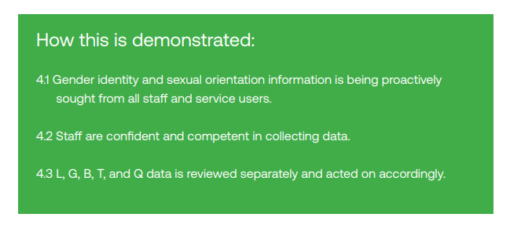
Pillar 4 - We take responsibility for collecting and reporting data
Suggested actions:
Use training to build staff confidence to ask and share about being LGBTQ+ to collect better patient and workforce data.
Use best practice learning from data collection of other protected characteristics.
Take time to understand the quality of data needed to start making data-led decisions.
Allow improving data collection and use to be an iterative process.

Slide 10
Pillar 4 - We take responsibility for collecting and reporting data
Our progress:
4.1 Gender identity and sexual
orientation information is being
proactively sought from all staff and
service users.
4.2 Staff are confident and competent
in collecting data.
4.3 L, G, B, T, and Q data is reviewed
separately and acted on accordingly.
Actions to date:
Add details here

Slide 11
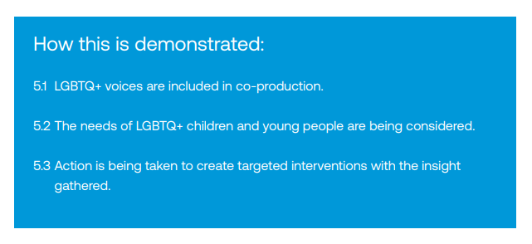
Pillar 5 - We listen to our service users
Suggested actions:
Approach engagement with service users with an open mind – there are numerous ways to engage meaningfully.
Take time to develop meaningful relationships based on mutual trust.
Consistently engage with your service users beyond the specific projects for which you are using their expertise.

Slide 12
Pillar 5 - We listen to our service users
Our progress:
5.1 LGBTQ+ voices are included in
co-production.
5.2 The needs of LGBTQ+ children
and young people are being
considered.
5.3 Action is being taken to create
targeted interventions with the insight
gathered.
Actions to date:
Add details here

Slide 13
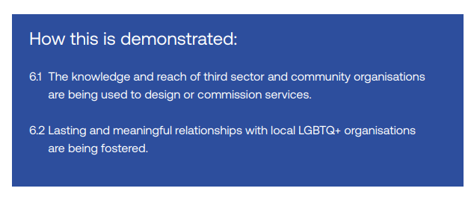
Pillar 6 - We proactively seek out partners to co-deliver services
Suggested actions:
Consider partnership opportunities at the national, regional and local level.
Invest time in building and maintaining trust with small community organisations.
Use the integrated care system population health focus for engagement and co-development with partners outside the health service.

Slide 14
Pillar 6 - We proactively seek out partners to co-deliver services
Our progress:
6.1 The knowledge and reach of third
sector and community organisations
are being used to design or
commission services.
6.2 Lasting and meaningful
relationships with local LGBTQ+
organisations are being fostered.
Actions to date:
Add details here

Slide 15

Next steps
Include details on your proposed next steps.

